Slide 1
Beach Cleaners – Ards & North Down
Individual Quick Reference Guide for Web Elements
CSC1034 Group Project – Student: 40481826

Slide 2
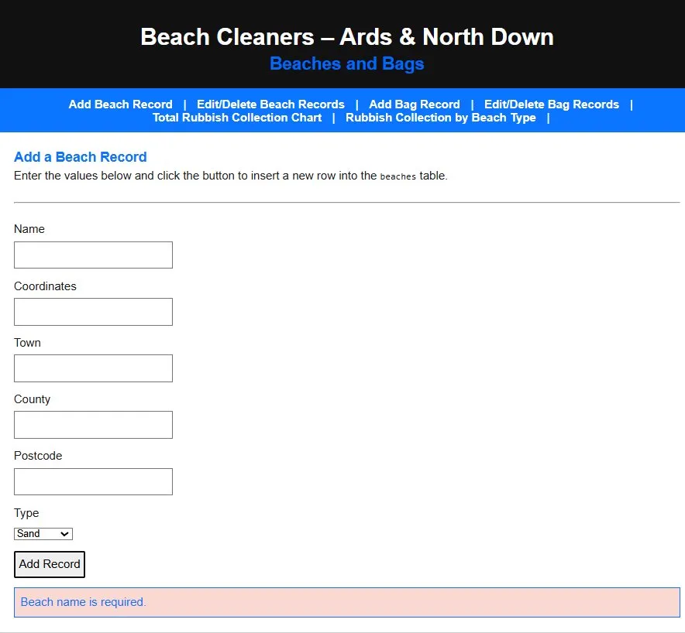
Client-Side Validation
Feature: Validation Error
When the client attempts to add a new Beach record with no name an error message displays in red saying, “Beach name is required.” This is the same for all other records within the Beach and Bag tables.
File: addBeach.html
Uses validateBeach() in js/script.js to ensure the new record added aligns with the database and its NOT NULL constraints.

Slide 3
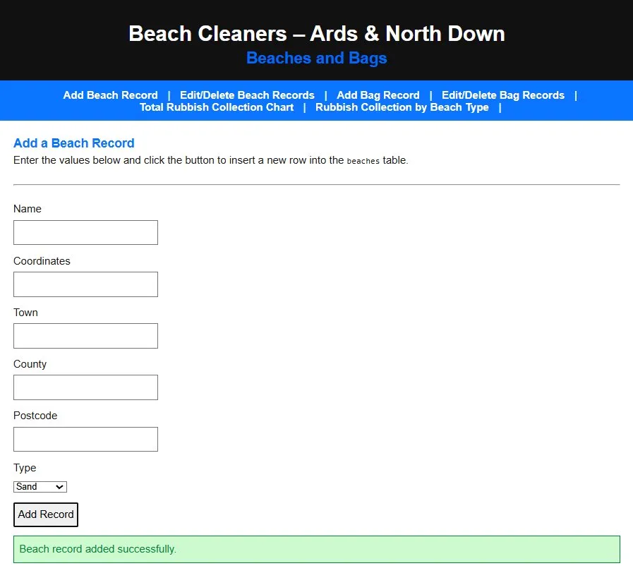
User Feedback
Feature: Success Feedback
After a new Beach Record has been inserted into the database a message displays in green saying, “ Beach record added successfully.” The same happens when adding a new Bag Record.
File: addBeach.html
Uses showMessage() to output the success message when a record that meets all the validation is input.

Slide 4
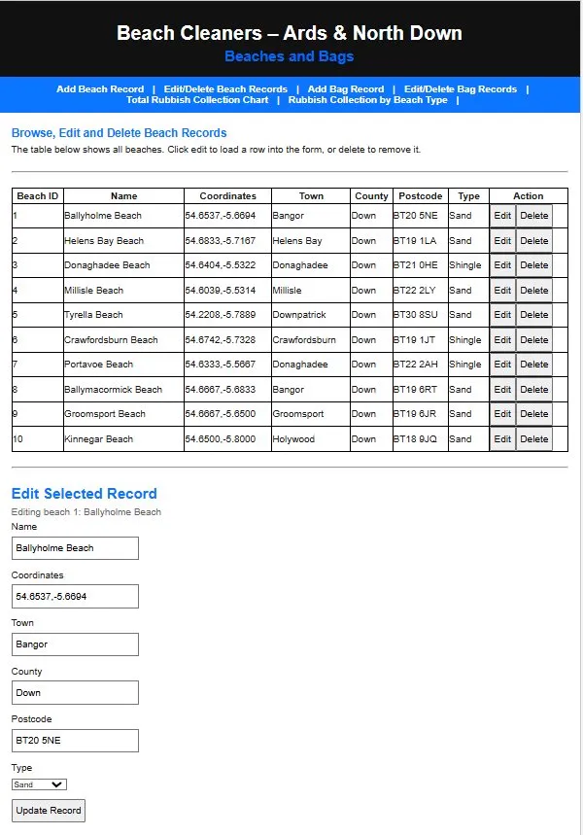
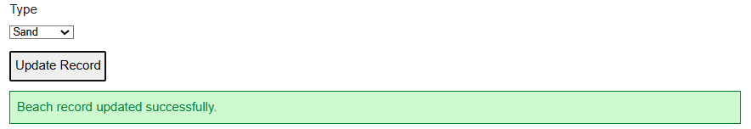
CRUD – Edit Record
Feature: Edit Record
When the “Edit” button is clicked on any row of the table, the beach data from that row is loaded into the form below the table. The user can change the values of any of the fields and, if the new values meet all the validation, when the user clicks “Update Record” the changes are saved to the database and a message displays in green saying, “Beach record updated successfully.”
File: editDeleteBeach.html
Uses functions selectBeach(), printTable() and UPDATE SQL via the runQuery() to print the table of records, allow the user to select a record to edit and update the table to display the new changes.

Slide 5
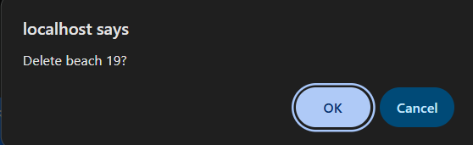
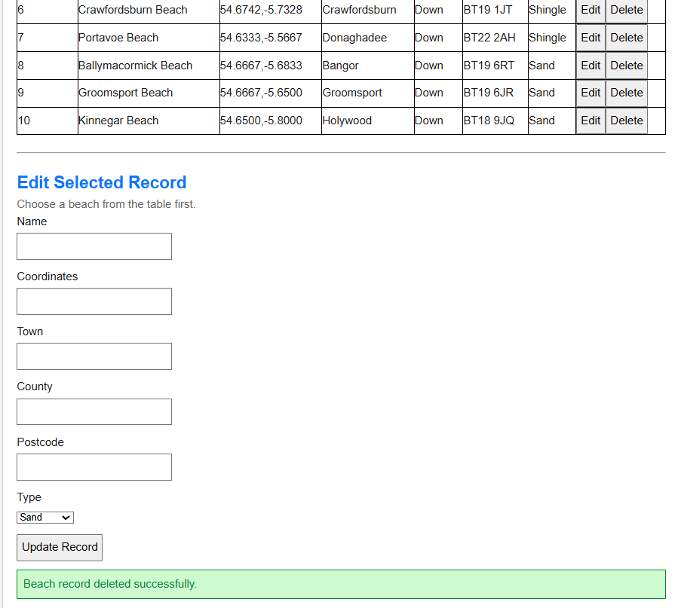
CRUD – Delete Record
Feature: Delete Record
When the user clicks the “Delete” button for a record a dialog box appears on the browser asking the user to either confirm their choice or cancel it. If the user clicks “OK” a message displays in green saying, “Beach record deleted successfully.”
File: editDeleteBeach.html
Uses confirm() before DELETE SQL via the runQuery() to ensure the user confirms this choice and has a chance to cancel in case they click accidentally.

Slide 6
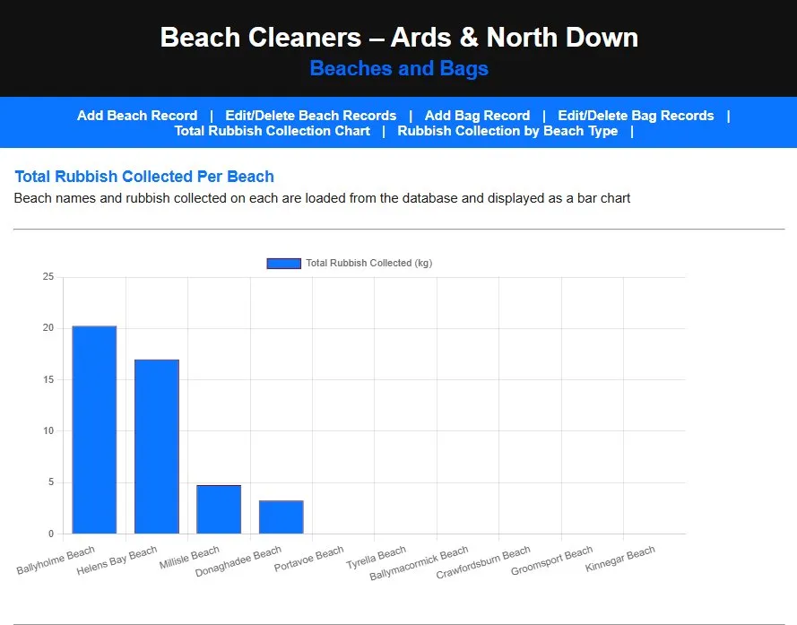
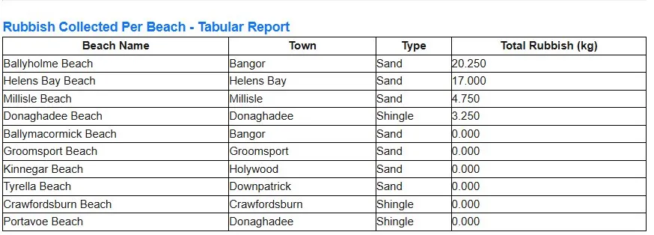
Dynamic Data – Chart and Tabular Report
Feature: Live Bar Chart
Chart.js bar chart that shows the total rubbish collected per beach. The data is loaded live from the database using a LEFT JOIN across tblBeach, tblBeachCleanEvent and tblBag.
Feature: Tabular Report
A table showing the Beach Name, Town, Type and Total Rubbish (kg). This data is also loaded live from the database, both the chart and table are shown on the same page, loaded simultaneously.
File: chart.html
Uses printChart() and printTable() to print both to the page upon loading.

Slide 7
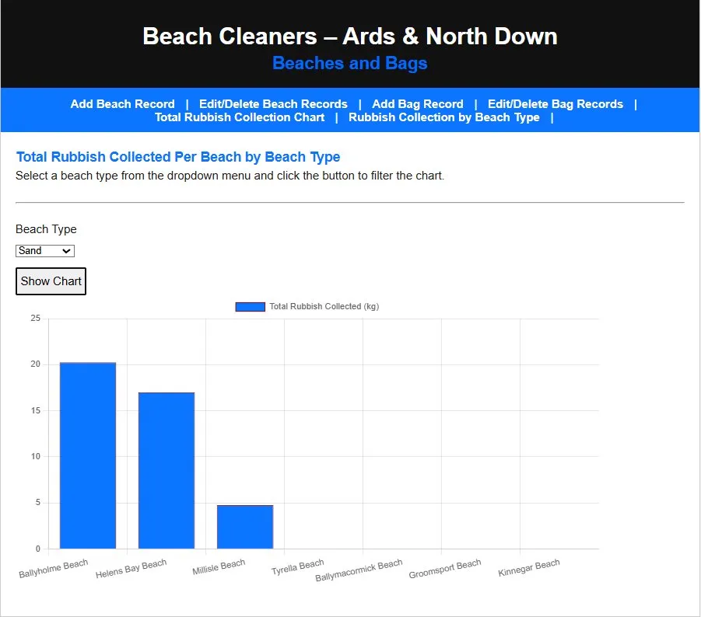
Parameterised Chart
Feature: Parameterised Chart
User selects a beach type (Sand/Shingle/Unknown) from a dropdown menu and clicks the “Show Chart” button. The chart will update to only show the beaches that match the chosen filter.
File: paramChart.html
Uses a WHERE clause to filter the chart by the Beach Type parameter.

